Slide 1


Project – X02 Employability Assessment Toolkit
Muhammad Daniyal (30385522)
Sukhtindervir Kaur (30383565)
Suraj Mahat (30391411)
Roshan Shrestha (30385741)
Pratik Lamichhane (30386632)

Slide 2
Project Overview
Development of employability assessment portal
Career assessment tool
CV assessment tool
Career development planning tool
Students
Job seekers
Stakeholders
These tools will help:
It will contain following tools:

Slide 3
Clients
PROJECT DIRECTOR – Supriyo Chaudhuri (Chief Learning Officer), based in the UK
Anirudh Phadke (Head of Digital Content), currently based in Delhi
Marketa Mojzisova (E/L Programme Manager), currently based in Melbourne

Slide 4
Team Structure
PRODUCT OWNER
SCRUM MASTER
TEAM MEMBERS
Suraj Mahat
Roshan Shrestha
Pratik Lamichhane
Sukhtindervir Kaur
Muhammad Daniyal

Slide 5
Tools used
Communication
MS Teams
Google Meet
Documentation
MS Word
Google Docs
Project Management
GitHub (Code management)
Trello

Slide 6
Technologies used
HTML5, CSS3, JavaScript
MySQL, PHP
Moodle LMS, H5P, HTMS, Power BI
Pencil software

Slide 7
Work Done
Initial project preference bid
Team formation
Project vision statement
Initial product backlog
Project handbook

Slide 8
Work Done
Initial Project Plan
Sprint/Iteration documentation
Sprint/Iteration demonstration
Review meeting
Retrospective meeting

Slide 9
Demonstration
Research about similar solutions
Wireframing for Employability Assessment Portal
Development of Employability Assessment Portal

Slide 10
Demonstration
CV assessment tool
Career assessment tool
Career development planning tool
Feedback pages
Subscription pages
Sign up and login page

Slide 11
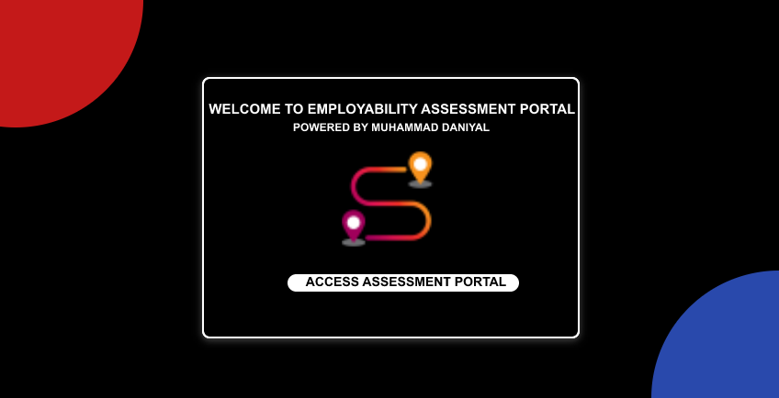
PROTOTYPE

Slide 12
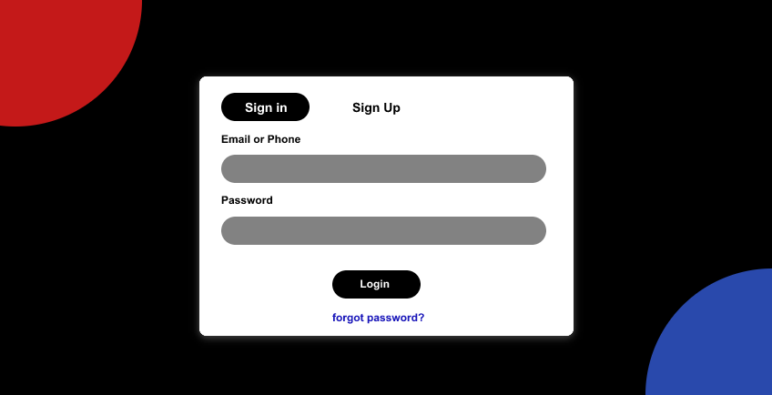
PROTOTYPE

Slide 13
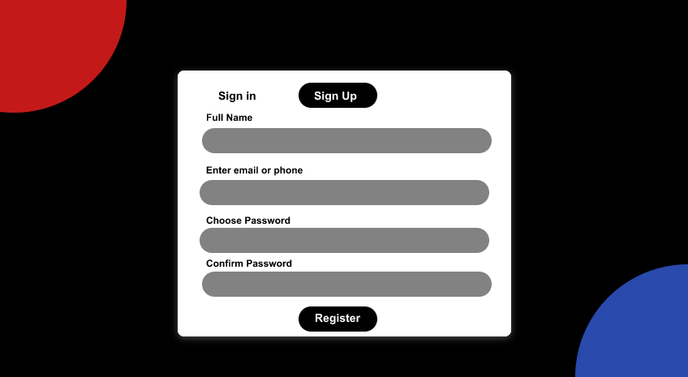
PROTOTYPE

Slide 14
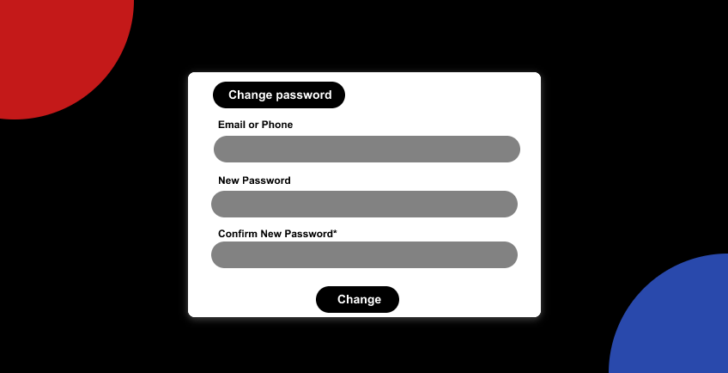
PROTOTYPE

Slide 15
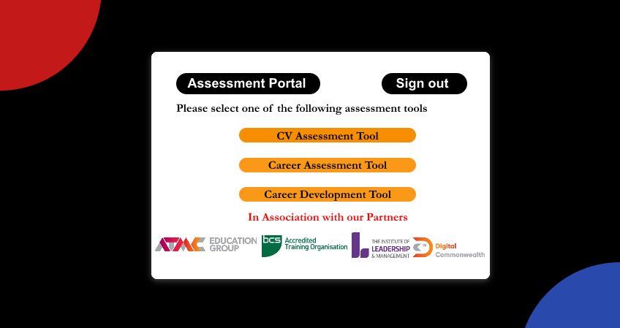
PROTOTYPE

Slide 16
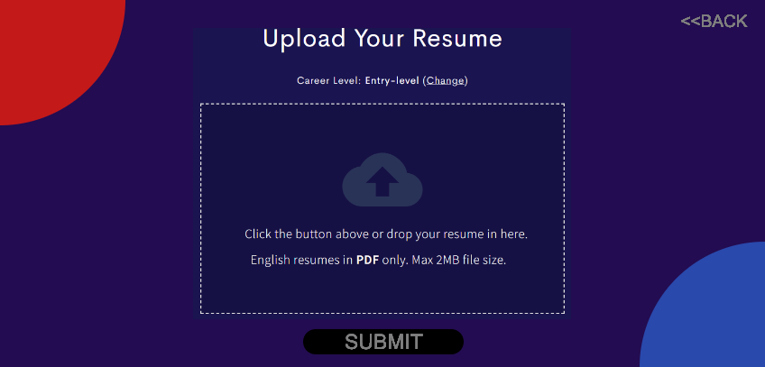
PROTOTYPE

Slide 17
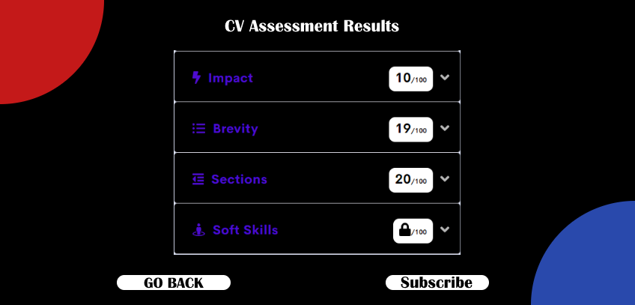
PROTOTYPE

Slide 18
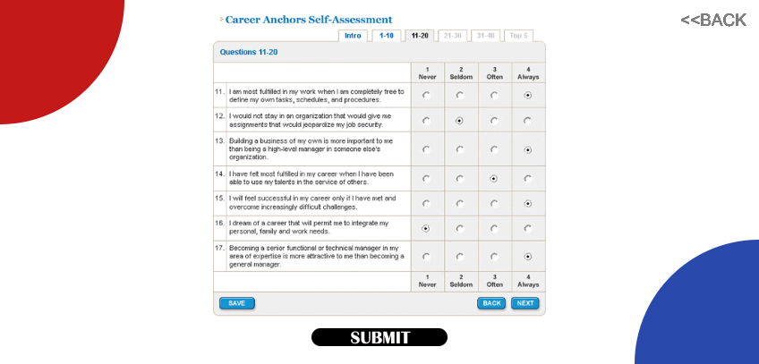
PROTOTYPE

Slide 19
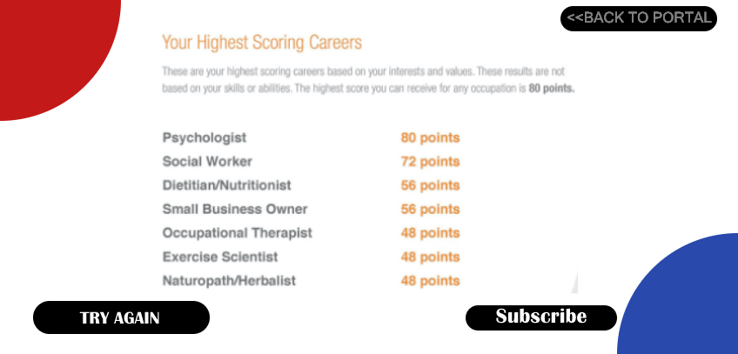
PROTOTYPE

Slide 20
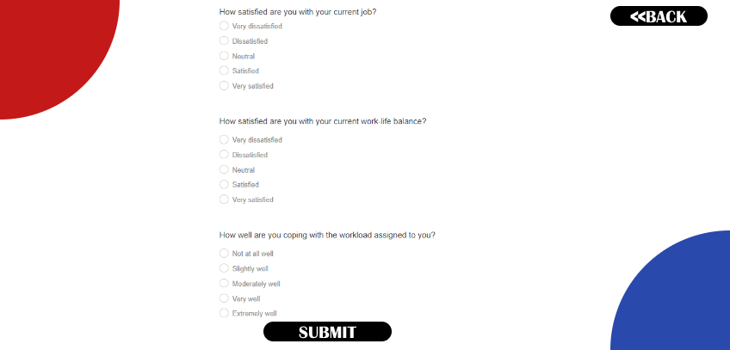
PROTOTYPE

Slide 21
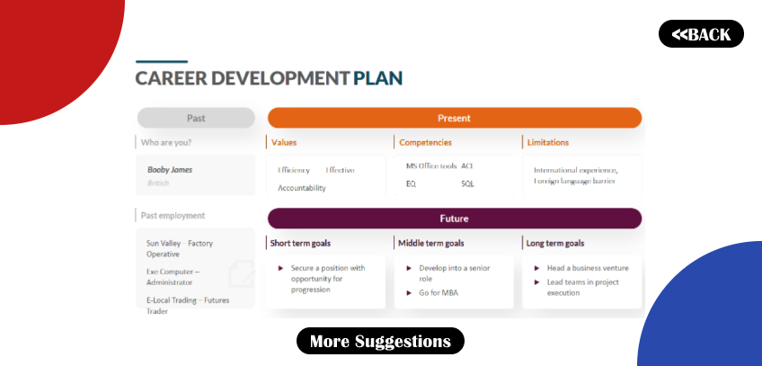
PROTOTYPE

Slide 22
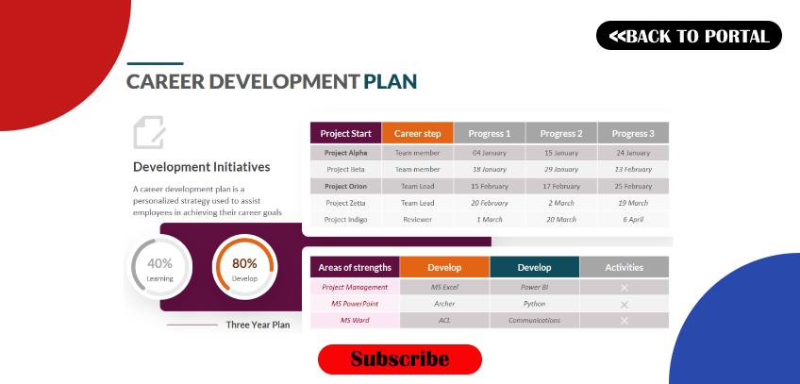
PROTOTYPE

Slide 23
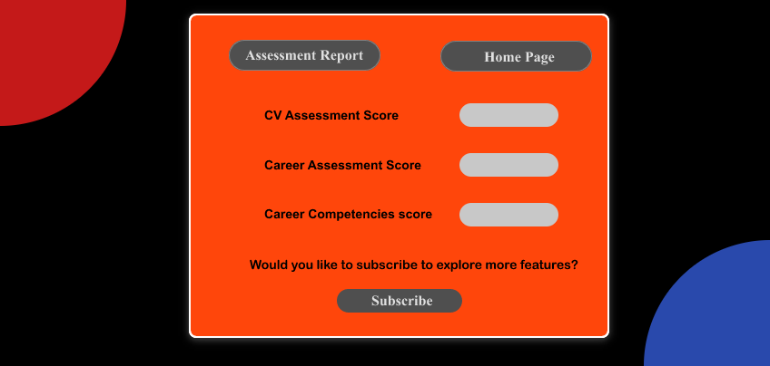
PROTOTYPE

Slide 24
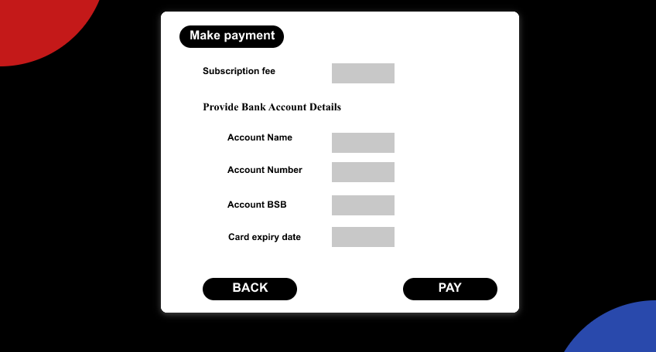
PROTOTYPE

Slide 25
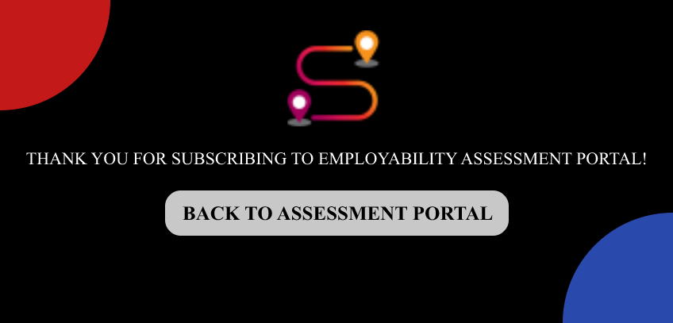
PROTOTYPE

Slide 26

Demonstration
Link for the prototype: https://mdaniyalmuz.invisionapp.com/prototype/cl2otpxsh00g3y301i2k267yg/play

Slide 27
Client’s Feedback
The sign-up page should have one more text field for the confirmation of the password.
For the CV assessment tool, user must be able to upload the resume file in various format such pdf and word document.
For the feedback page of the CV assessment tool, the scores for the different skills must be provided to the user along the drop menu which must explain the user’s resume score against specific criteria.
Overall, the client was happy with the demo of the prototype, and he appreciated our work towards the final product of the project.

Slide 28

Reflection
What went right?
Tasks were completed before allocated time.
Client meeting went well.
Prototype demonstration went well.

Slide 29
REFLECTION
What went wrong?
We could have started working on Trello.
Communication between team could have been improved.
How is it being addressed?
We have started working with Trello.
We are collaborating with team members.

Slide 30
THANK YOU

